Slide 1
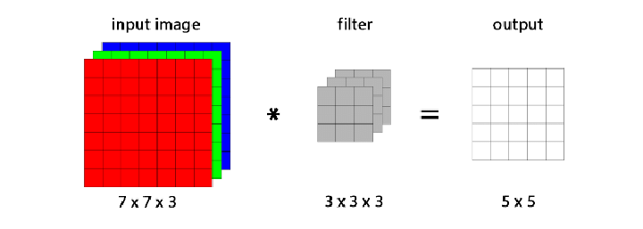
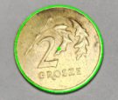
ATM Cash Predictor
Notes:
https://github.com/muhammadowaismushtaq/ATM-Cash-Predictor

Slide 2
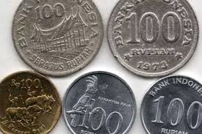
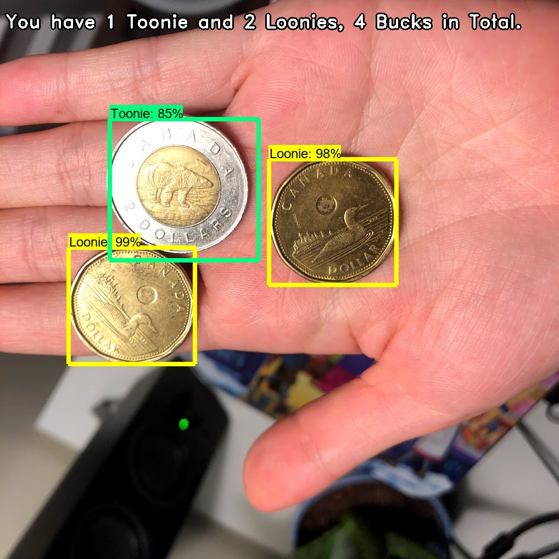
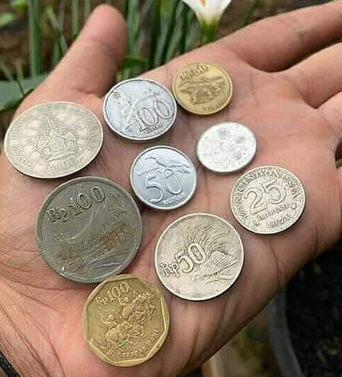
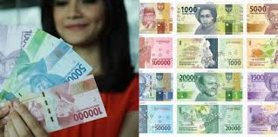
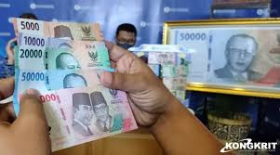
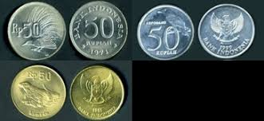
Counting Coint

Slide 3
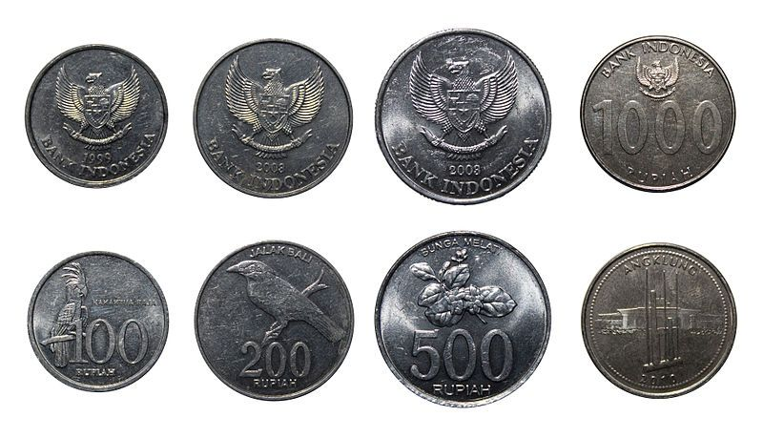
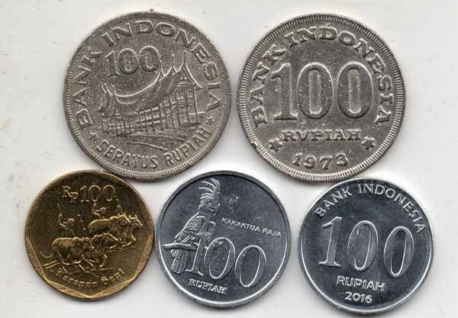
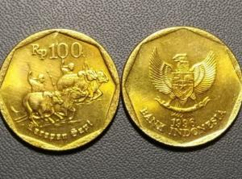

Slide 4
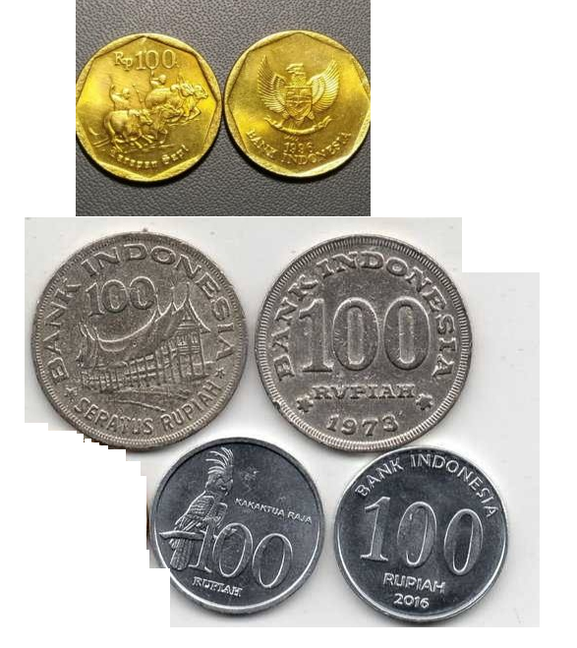
100_Emas, 95 %
100_Emas, 90 %
100_PB, 95 %
100_PB, 95 %
100_Perak, 95 %
100_Perak, 98 %
Notes:
https://symmehub.github.io/positron/image_processing/exercises/image_processing_tutorial.html

Slide 5
Pre-Processing
Notes:
https://ai.plainenglish.io/4-classical-feature-extraction-techniques-you-must-try-7ea0969e9c23

Slide 6
7 x 7 x 3
7 x 7 x 3
3 x 3 x 3
-1 | -2 | -1
0 | 0 | 0
1 | 2 | 1
X
=
Coin
Input
Kernel
Output
Notes:
https://towardsdatascience.com/canny-edge-detection-step-by-step-in-python-computer-vision-b49c3a2d8123
https://vincmazet.github.io/bip/detection/edges.html

